Slide 1
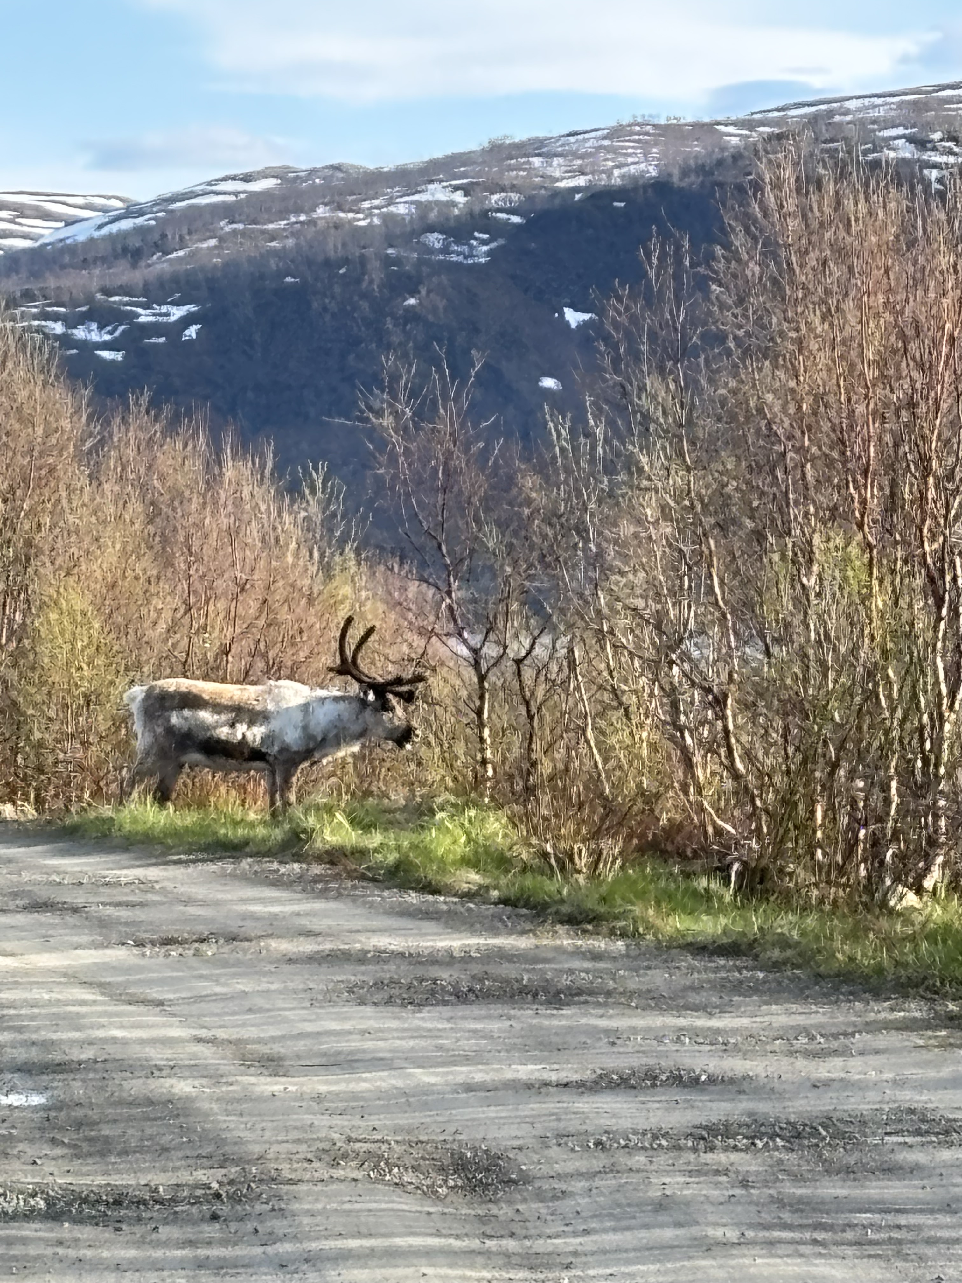
Understanding Emotions through Grammar
Laura A. Janda, UiT
Dominika Kováříková, Charles University

Slide 2
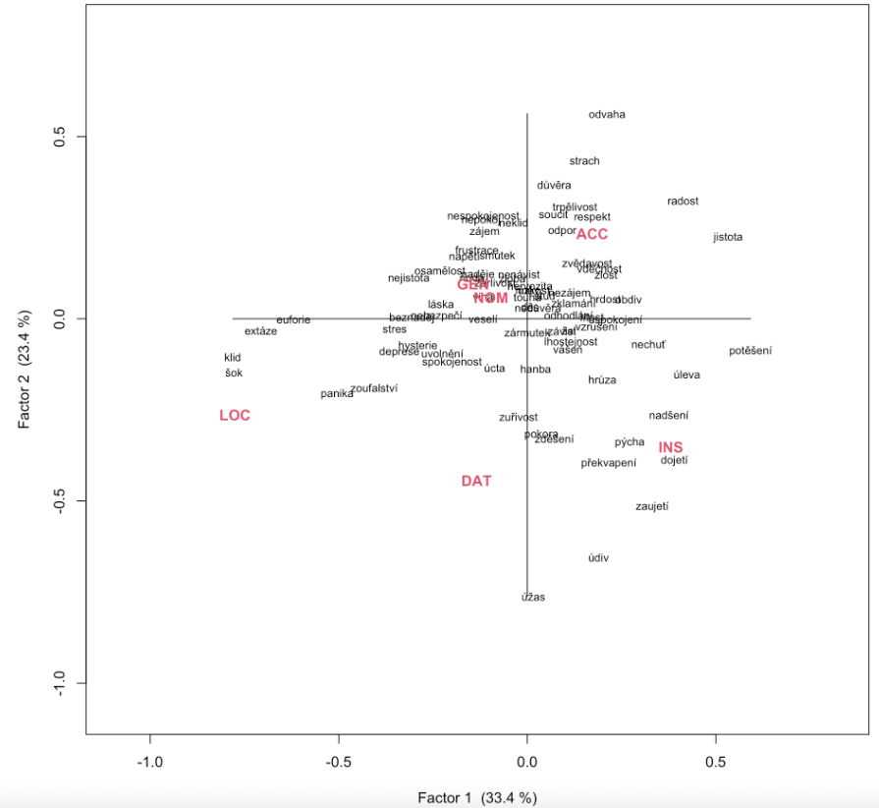
Sneak preview
metaphorical
possessions
Some words are strongly attracted to certain grammatical cases, where they serve as metaphorical possessions, containers, agents, or accessories
metaphoricalcontainers
metaphorical agents, accessories

Slide 3
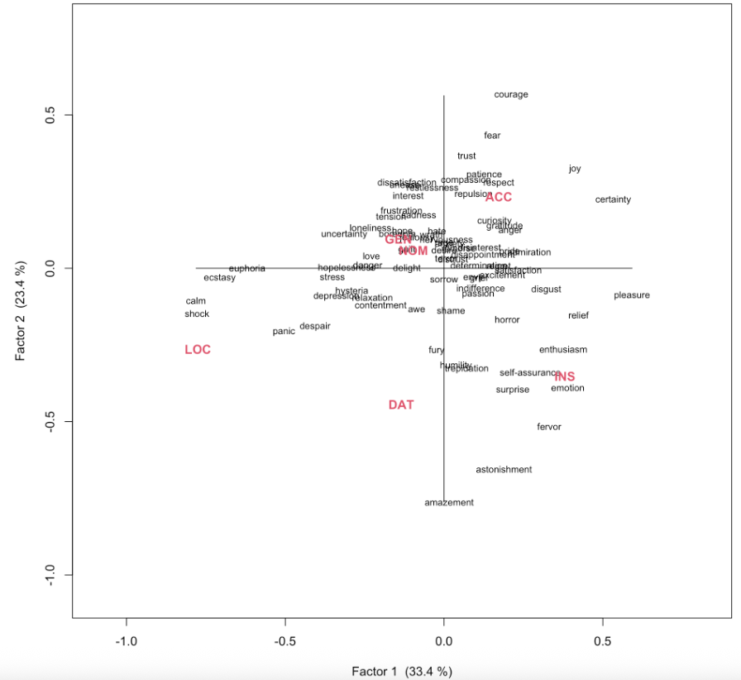
Sneak preview
metaphorical
possessions
(with English glosses)
Some words are strongly attracted to certain grammatical cases, where they serve as metaphorical possessions, containers, agents, or accessories
metaphoricalcontainers
metaphorical agents, accessories

Slide 4
Understanding Emotions Through Grammar
Overview
Lexical meaning and grammatical meaning as a continuum
Grammar supplements and differentiates meaning
Grammatical case and meaning
Classification of emotions
Grammatical profiles: vectors of distribution in corpus data
SMARTool, GramatiKat
Data and analysis of Czech emotion words
What does this buy us?
Theoretical contribution
Lexicography
Language pedagogy

Slide 5
Lexical meaning and grammatical meaning as a continuum

Slide 6
Does grammar mean anything?
Is grammar mere “plumbing”?
Or is it more like a sound track, a drumbeat?

Slide 7
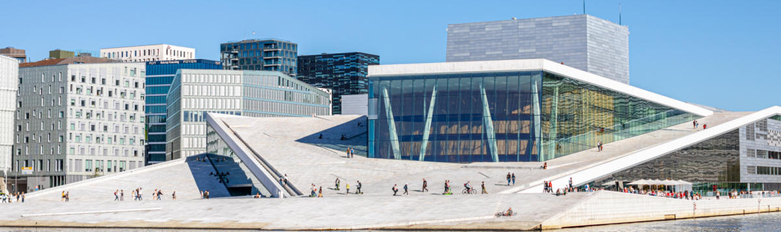
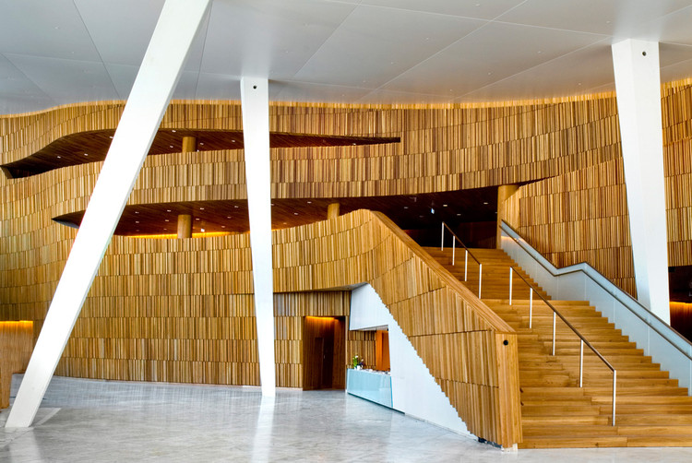
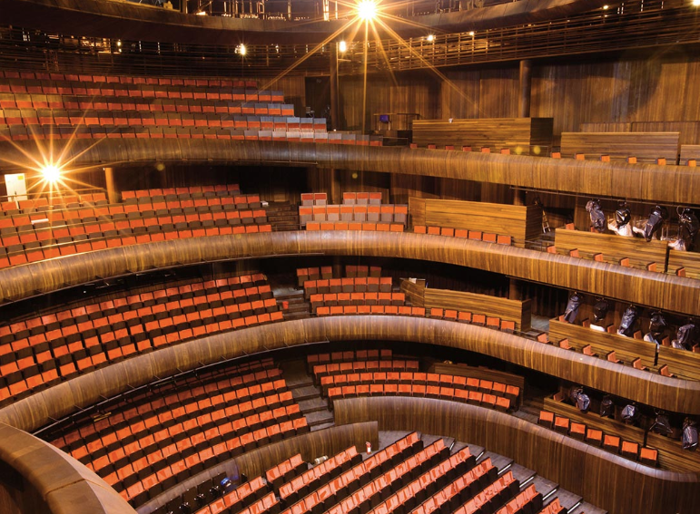
Perception of architecture

Slide 8

Perception of architecture

Slide 9

Perception of film
Voice
+
Soundtrack
“Background music”
is an important part of the message

Slide 10
Grammar as a drumbeat
Grammar is obligatory, systematic
Czech nouns are obligatorily marked with one of seven cases
Cases bear abstract meanings
Each noun has its own “personal preferences”, cases that it is attracted to or repelled from, like an individual rhythm

Slide 11
Theoretical grounding
“grammar is symbolic in nature … grammar and lexicon form a continuum”(Langacker 2008: 161)
cf. also Goldberg 1995 & 2006, Croft 2001, Fillmore’s FrameNet, etc., and see more citations in Boas 2010
Not a new idea, cf. Bühler (1982) and other earlier discussions of form-meaning relationship

Slide 12
Grammatical case and meaning

Slide 13
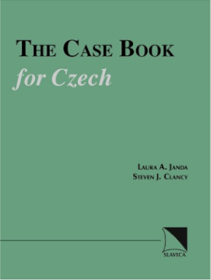
The Case Book for Czech (Janda & Clancy 2006)
Goal: explain the motive for all uses of the seven grammatical cases in Czech
“Case meaning takes as its point of departure the relationships that hold between physical objects placed or moving in space. These relationships can be metaphorically transferred to other domains such as time or social interactions”
case semantics are to some extent language-specific (no claim of universality)
cf. also Janda & Clancy 2002 The Case Book for Russian

Slide 14
Overview of the case meanings
For each case:
Schematic meaning
Abstract overall idea
Network of 1 to 4 meaning nodes
Structured polysemy: meanings are related to each other
Metaphorical and metonymic extensions, usually from space to other domains: time, purpose, etc.

Slide 15
Nominative
Nominative: Identification
NOMINATIVE: A NAME
Used to point out an item
The grammatical subject, the active agent in a situation
NOMINATIVE: AN IDENTITY
With verbs meaning ‘be’ as in ‘X is Y’ [Domovník není nepřítel ‘The janitor isn’t an enemy’], where “X” (janitor) is NOMINATIVE: A NAME as the grammatical subject, while “Y” (enemy) is NOMINATIVE: AN IDENTITY.

Slide 16
Genitive: Backgrounded with respect to something in proximity
Genitive
GENITIVE: A SOURCE
Point of departure specified by prepositions meaning ‘from’ (z, s, od…), verbs expressing withdrawal (stranit se ‘avoid’, bát se ‘be afraid of’…); extended metaphorically to time, cause, human relationships.
GENITIVE: A GOAL
Point of attainment specified by prepositions (do ‘up to, until’), verbs and adjectives expressing (mostly metaphorical) approach (dočkat se ‘wait for’, dotknout se ‘touch’…); extended metaphorically to time, purpose, states of being.
GENITIVE: A WHOLE
Part of a larger unit; ‘of’, possession; participant in a nominalized event (setkání dětí ‘meeting of children’); complex prepositional phrases; quantification (milión dolarů ‘a million dollars’); verbs of consumption (přejíst se knedlíků ‘eat too many dumplings’).
GENITIVE: A REFERENCE
Proximal landmark (u ‘by, at’ and other prepositions); temporal setting; preposition bez ‘without’

Slide 17
Dative: Capacity to interact with surroundings
Dative
DATIVE: A RECEIVER
indirect object (Jan dal mamince knihu ‘Jan gave his mother a book’), includes many verbs without an overt direct object, such as verbs of communication and payment.
DATIVE: AN EXPERIENCER
Expressions of harm, benefit, belonging to, enjoyment; experience of environment, emotions.
DATIVE: A COMPETITOR
With words expressing domination, matched competition or submission to a greater force; k ‘toward’ identifies a person or entity that exerts influence.

Slide 18
Accusative: Path toward a destination
Accusative
ACCUSATIVE: A DESTINATION
Direct object; path specified by prepositions (v ‘into’, na ‘onto’, za ‘beyond’, pod ‘under’…); metaphorical extensions to domains such as time, purpose, change of state.
ACCUSATIVE: A DIMENSION
Distance or size (ujet třicet kilometrů ‘ride thirty kilometers’), duration (spát celou noc ‘sleep the whole night’); prepositions specify path contours (skrz ‘through’, přes ‘across’).

Slide 19
Vocative: Call for attention
Vocative
VOCATIVE: A CALL
Let someone know that the speaker is talking to them rather than about them: Maminko a tatínku! ‘Mom and dad!’

Slide 20
Locative: Location
Locative
LOCATIVE: A PLACE
Locations in space or other domains specified by prepositions v ‘in’, na ‘on’, při ‘at’, o ‘about’, po ‘after’ (v Moskvě ‘in Moscow’, na stole ‘on the table’).

Slide 21
Instrumental: Peripheral conduit or attachment
Instrumental
INSTRUMENTAL: A MEANS
Conduit for an action (šli jsme lesem ‘we walked through the forest’); instrument that makes an action possible (řezat maso nožem ‘slice meat with a knife’); with verbs signifying control and evaluation (vládnout něčím ‘use something masterfully’); passive agent (Dopis napsán otcem ‘The letter was written by father’); facilitator in a sentence lacking a grammatical subject (Polilo ho horkem ‘A sensation of heat poured over him’).
INSTRUMENTAL: A LABEL
With verbs denoting being, becoming, and seeming to identify a category that something belongs to (Proč nejsem ctitelem Václava Klause ‘Why I am not an admirer of Václav Klaus’).
INSTRUMENTAL: AN ADJUNCT
Preposition s ‘with’ (Marie přišla s Janem ‘Marie came with Jan’).
INSTRUMENTAL: A LANDMARK
Prepositions nad ‘above’, pod ‘under’, před ‘in front of’, za ‘behind’, mezi ‘between’.

Slide 22
Classification of emotions

Slide 23
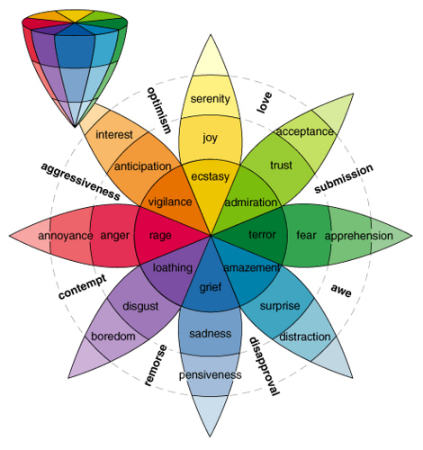
Plutchik’s Wheel of Emotions (1980)
[nouns]

Slide 24
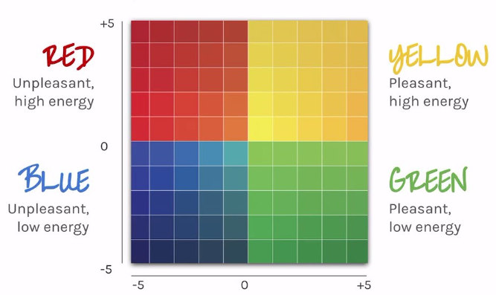
Brackett’s (2019) “mood meter”

Slide 25
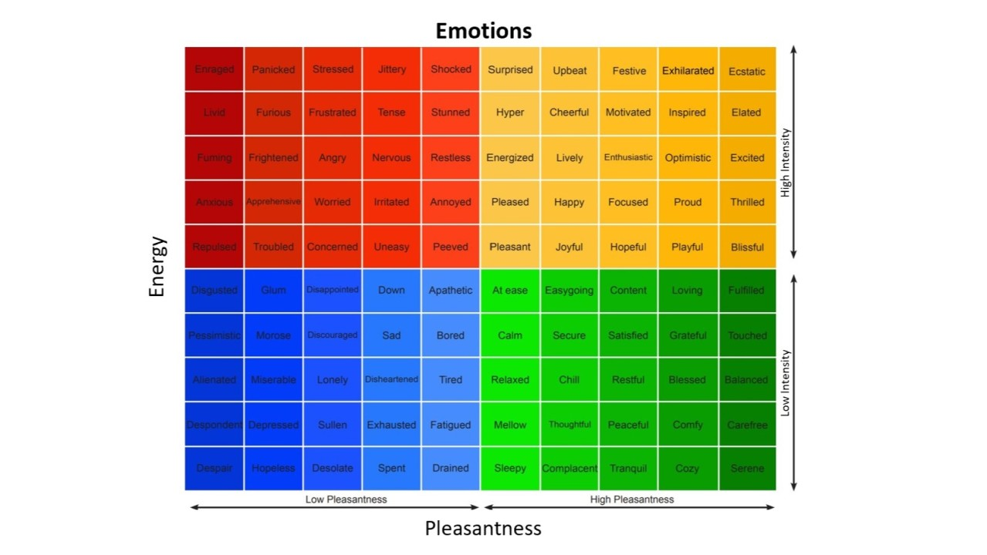
[adjectives]

Slide 26
Grammatical profiles: vectors of distribution in corpus data

Slide 27
Janda & Solovyev 2009: What constructional profiles reveal about synonymy: A case study of Russian words for SADNESS and HAPPINESS
Based on hand-coding of 500 example sentences for each word extracted from the Russian National Corpus and Biblioteka Maksima Mošova
“Constructional profiles” show the vectors of preposition + case constructions for Russian synonyms
‘sadness’: pečal’, toska, xandra, melanxolija, grust’, unynie
‘happiness’: naslaždenie, radost’, udovol’stvie, likovanie, vostorg

Slide 28
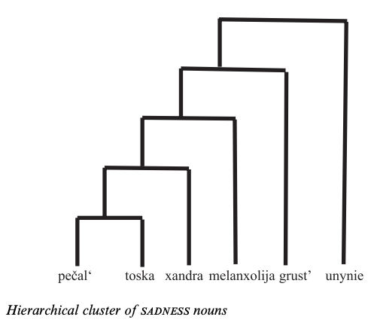
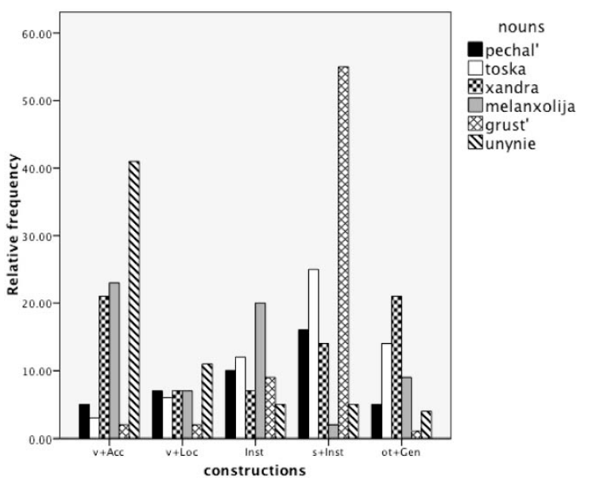
“We present the constructional profile, the relative frequencies of constructions a word appears in, as a possible measure of a word’s meaning.”

Slide 29
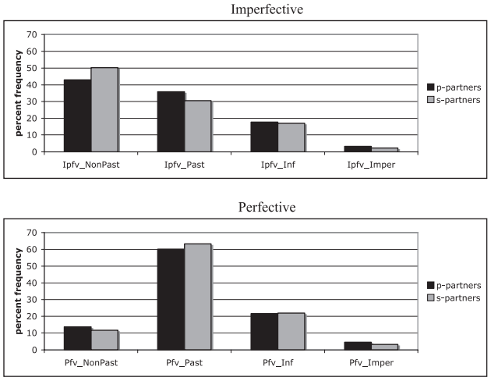
Janda & Lyashevskaya 2011: Grammatical profiles and the interaction of the lexicon with aspect, tense, and mood in Russian
Based on data in the Russian National Corpus
Differences between perfective and imperfective verbs are the same regardless of whether aspect is marked by prefixes or suffixes.
“Grammatical profiles make it possible to identify verbs that behave as outliers, presenting unusually large proportions of usage in parts of the paradigm.”

Slide 30
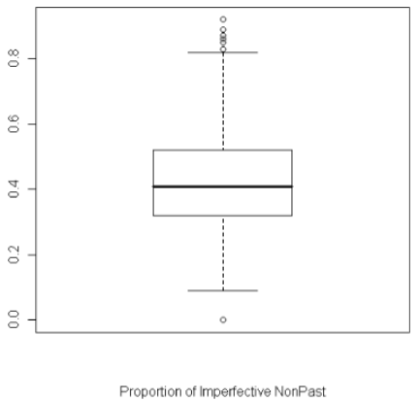
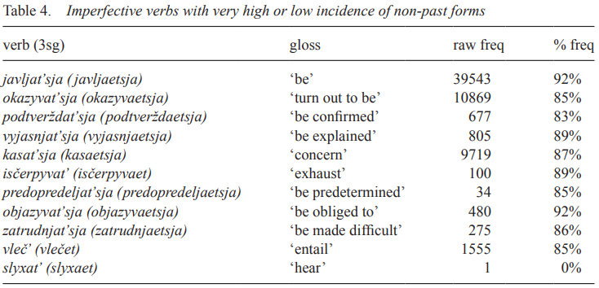
Contrary to the traditional assumption that Imperfective non-past (≈ present) tense expresses actions ongoing at the moment of speaking, the verbs most attracted to this TAM combination express gnomic (timeless) states and facts.
[One example out of the 8 TAM combinations]

Slide 31
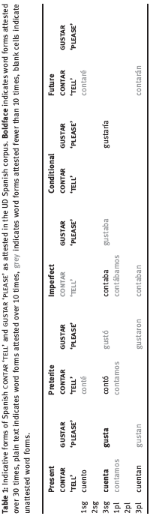
Janda & Tyers 2018/2021: Less is more: why all paradigms are defective, and why that is a good thing
“Native speakers of languages with complex inflectional morphology routinely recognize and produce forms that they have never heard or seen (the “Paradigm Cell Filling Problem”, cf. Ackerman et al. 2009). How is this possible? We take a learning perspective on this question and present evidence to show that inflectional morphology can be mastered through partially overlapping portions of paradigms in input.”

Slide 32
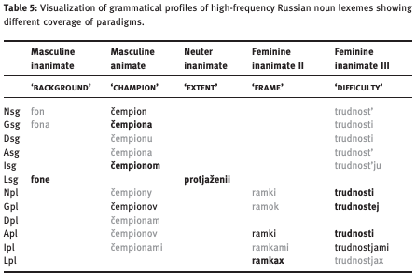

Slide 33
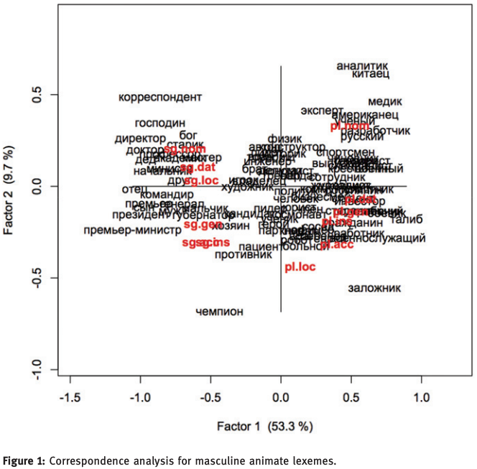

Slide 34
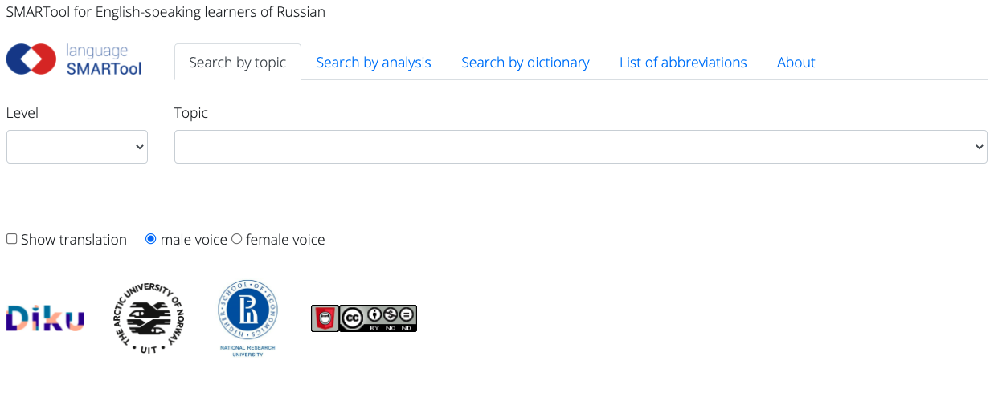
Find the SMARTool here:
https://smartool.github.io/smartool-rus-eng/

Slide 35
Janda et al. 2022: The Case for Case in Putin’s Speeches
Putin’s speeches at time of 2022 invasion
Keymorph Analysis: comparison of grammatical profiles of Rossija ‘Russia’, Ukraina ‘Ukraine’, NATO ‘NATO’ in speeches with frequency distributions in reference corpus
Deviant use of case supports a narrative that “depicts Russia as a dynamic, agentive, foregrounded actor, a reliable partner for collaboration, but also the victim of unfair geopolitical maneuvers. Ukraine, by contrast, is dehumanized as relatively static and backgrounded, often merely a territorial location rather than a state. NATO appears primarily as the label for an untrustworthy organization and a destination for Ukraine.”
Forthcoming: a longitudinal comparison of Putin’s use of case 2022-2024

Slide 36
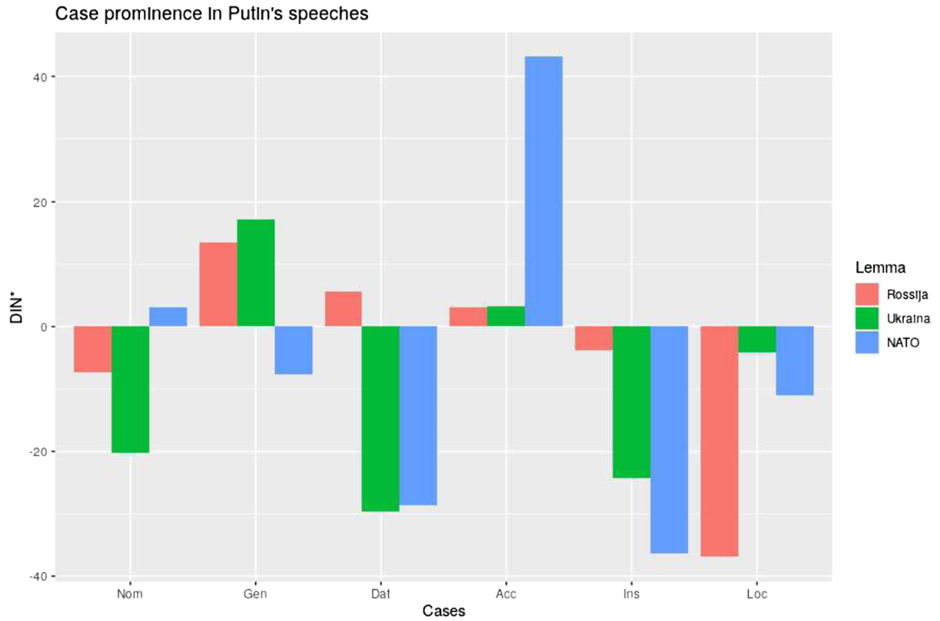

Slide 37

https://korpus.cz/gramatikat/
Proof-of-concept for grammatical profiling at scale
Based on Czech SYN2015 and SYN2020, two representative reference corpora totaling 200M words
Grammatical profiles for all lemmas attested 100 or more times in the composite corpus belonging to the three major parts of speech: nouns, verbs, and adjectives.
Whereas the frequencies of inflected forms are in principle available in digital corpora, baseline grammatical profiles for an entire lexicon are “impossible to acquire … from a standard corpus interface such as KonText, AntConc, or SketchEngine, at least not without enormous effort” (Kováříková et al. 2023).

Slide 38
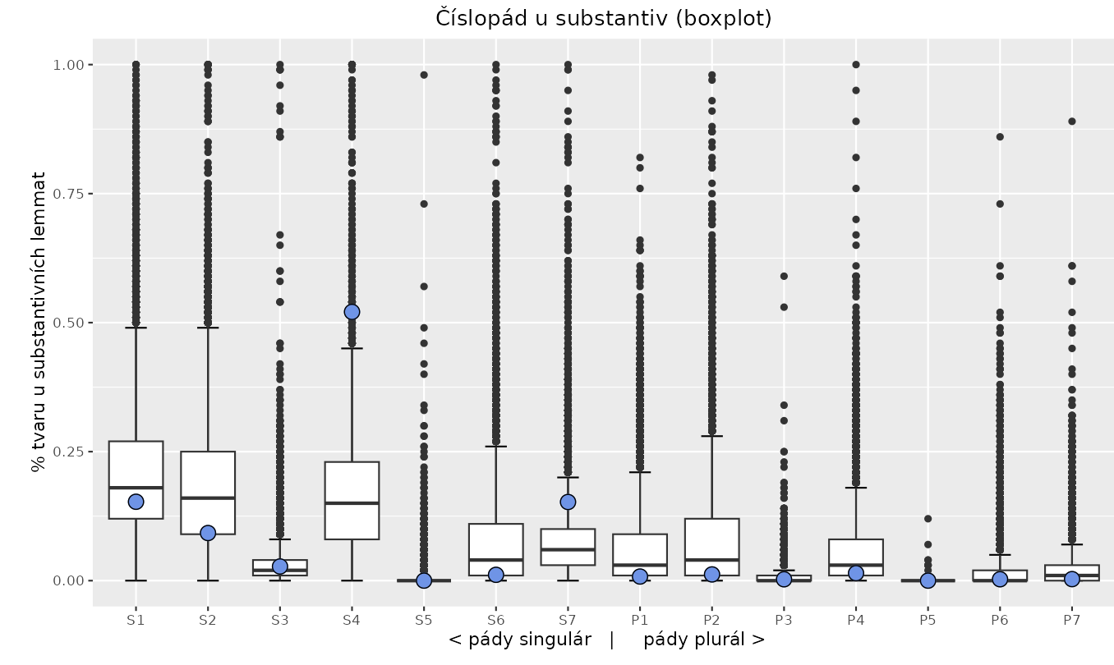
Grammatical profile of radost ‘joy’ (blue dots) vs. distribution for nouns attested ≥ 100 in SYNv11 corpus
Cases: 1 = Nominative, 2 = Genitive, 3 = Dative, 4 = Accusative, 5 = Vocative, 6 = Locative, 7 = Instrumental

Slide 39
Data and analysis of Czech emotion words

Slide 40
Czech data and analysis
Grammatical profiles from GramatiKat
78 nouns (frequency > 1000) describing emotions
Plural removed since all nouns in the list have over 90% of uses in Singular and most have 100% Singular.
Vocative Singular removed since it had zero value for most nouns. There is one noun with more than 1% use in VocSg: láska ‘love’ (3.1%). Second largest: pýcha ‘pride’ 0.3%.
Correspondence analysis of grammatical profiles

Slide 41
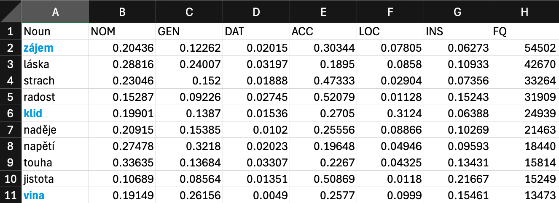
What the data looks like

Slide 42
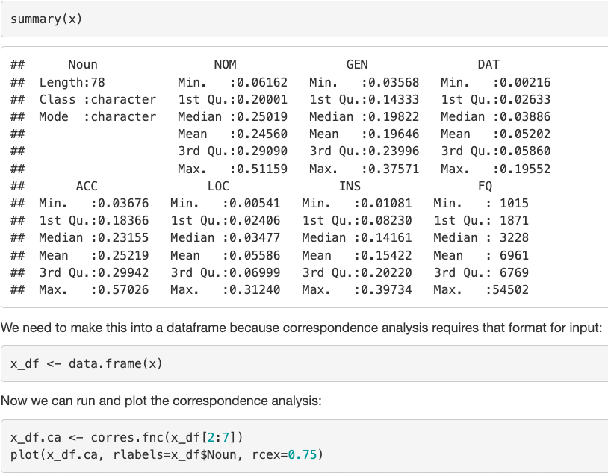
Data distribution and code

Slide 43
metaphorical
possessions
Some words are strongly attracted to certain grammatical cases, where they serve as metaphorical possessions, containers, agents, or accessories
metaphoricalcontainers
metaphorical agents, accessories

Slide 44
metaphorical
possessions
(with English glosses)
Some words are strongly attracted to certain grammatical cases, where they serve as metaphorical possessions, containers, agents, or accessories
metaphoricalcontainers
metaphorical agents, accessories

Slide 45
‘HAPPINESS’
radost
nadšení
euforie
extáze

Slide 46
‘FEAR’
strach
hrůza
panika
nebezpečí
děs
hysterie

Slide 47
‘TENSION’
napětí
úzkost
nervozita
stres

Slide 48
‘DISGUST’
odpor
nechuť

Slide 49
‘LOVE’
láska
vášeň

Slide 50
‘RESPECT’
respekt
úcta
obdiv

Slide 51
‘SURPRISE’
údiv
překvapení
šok

Slide 52
‘ANGER’
hněv
zlost
zloba
zuřivost

Slide 53
‘PRIDE’
hrdost
pýcha

Slide 54
‘SHAME’
hanba
stud

Slide 55
‘SORROW’
žal
smutek
zármutek

Slide 56
klid ‘calm’
šok ‘shock’

Slide 57
odvaha ‘courage’
strach ‘fear’

Slide 58
soucit ‘synmpathy’
odpor ‘repulsion’

Slide 59
úcta ‘respect’
hanba ‘shame’

Slide 60
What does this buy us?

Slide 61
Theoretical contribution
Interaction of lexicon and grammar in production of meaning
In contrast to emotion wheel, mood meter (focus on synonymy/antonymy and intensity), metaphorical understanding of emotions as agents, possessions, accessories, containers
Synonyms can behave very differently, antonyms quite similarly

Slide 62
Lexicography
Improved distinction between apparent synonyms
Improved description of actual use of words

Slide 63
Language pedagogy
Facilitates targeting of most relevant grammatical forms in L2 learning

Slide 64
Works cited
Boas, H. C. 2010. The syntax–lexicon continuum in Construction Grammar. A case study of English communication verbs. Belgian Journal of Linguistics, 24, 54–82.
Bühler, K. 1982. Sprachtheorie. Die Darstellungsfunktion der Sprache. Ungekürzter. Stuttgart & New York: Fischer.
Croft, W. 2001. Radical Construction Grammar. Oxford: Oxford university Press.
Goldberg, A. E. 1995. Constructions: A construction grammar approaches to argument structure. Chicago: Chicago University Press.
Goldberg, A. E. 2006. Constructions at work: The nature of generalization in language. Oxford: Oxford University Press.
Langacker, R.W. 2008. Cognitive Grammar: A Basic Introduction. Oxford: Oxford Univeristy Press.

